Slide 1











C.V.RAMAN GLOBAL UNIVERSITY
Development Of Happiness Index For Schools with Self Assessment Facilities
Under the Guidance of-
Ms. Anjana Mishra
Assistant Professor
Dept. Of CSIT
VARTIKA-1901227403
SOUMYA RAJ-1901227398
HARSH ADITYA-1901227372

Slide 2
















HAPPINESS INDEX
The Happiness Index is a comprehensive survey instrument that assesses the happiness, well being, and aspects of sustainability and resilience.
It can be calculated on various parameters upon which we want to rate happiness index of a small group of people or help in self assessment of an individual.

Slide 3












MOTIVATION
India ranked 139 out of 149 countries for happiness index.
More than 1 in 3 high school students had experienced persistent feelings of sadness or hopelessness in 2019.
For better understanding of teachers, schools , parents and education policy makers seeking to understand and enhance Student's happiness, school wellbeing, sustainability, educational parameters etc.

Slide 4




OBJECTIVE
Mental Health is something which is not much talked about. Individual generally between the age of 12-25 are dealing with high stress and mental disorders, also students are more vulnerable to fall a prey.
To prevent these mishaps our optimistic approach is to build a web app which helps to generate a happiness index for various schools based on the parameters affecting the environment of the school.
Based on results the school can work upon it to make a healthy and fit environment .
With the help of the self assessment done by students, teachers and parents can collectively guide their child and prevent them from mental health issues.

Slide 5




We will generate happiness index based on Level 1-10 with 10 being the happiest and vice versa.
APPROACH
These levels will be used as parameters to analyze mental health of the students through forms.
After we select our parameters based on which we have to generate happiness index:
The happiness index of the school will be generated after the self assessment forms are filled by students.
Based on result schools can take up actions to make changes and provide required environment.(Conclude using OLS regression)

Slide 6


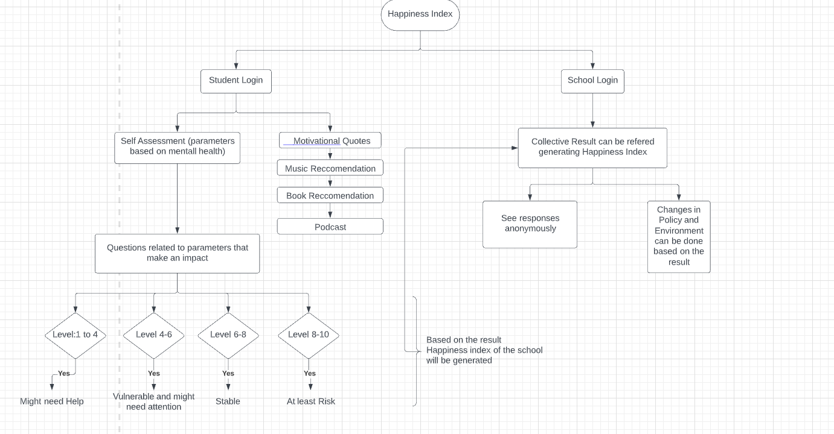





Work Flow

Slide 7








Literature Review
SL NO. | TITLE | AUTHOR (YEAR OF PUBLICATION) | METHODLOGY
1. 2. | Measuring Happiness in Academic Environment: A Case Study of the School Of Engineering at Taylor's University (Malaysia) Happiness Index Methodology | Applasamy, V., Gamboa, R. A., Al-Atabi, M., & Namasivayam (2014) Musikanski, L., Cloutier, S., Bejarano, E., Briggs, D., Colbert, J., Strasser, G., & Russell, S. (2017) | The measure of GIHI constitutes many key areas which can be classified as traditional areas and less traditional areas. The traditional areas of social concern are identified as living standards, health and education while the less traditional areas are time use, psychological wellbeing, environmental diversity and cultural diversity. The development procedures are described so survey instrument users understand the history of data collected by the Happiness Alliance and can use the information when analyzing data. The information may serve researchers seeking to understand the historical context of their own data collection and to compare their data to other collected by the Happiness Index and by other survey instruments.

Slide 8




Sl.NO | TITLE | AUTHOR (YEAR OF PUBLICATION) | METHODLOGY
3. 4. | Analyzing Happiness Index As A Measure With Its Parameters and Strategies For Improving India’s Rank in World Happiness Report. The effects of home and school on children’s happiness: a structural equation model | Sarah Ahtesham,(2017) Badri, M., Al Nuaimi, A., Guang, Y., Al Sheryani, Y., & Al Rashedi, A. (2018) | The research is mostly fundamental and descriptive in nature. It includes both quantitative evaluation as well as qualitative understanding of the concept. Past trends are observed and graphs and charts are constructed accordingly to understand the future possibilities. This section presents the empirical context of this research and discusses the sample used, the instrument developed for the study, and the analytical methods used in addressing the objectives of the study.

Slide 9



Sl.No. | TITLE | AUTHOR (YEAR OF PUBLICATION) | METHODLOGY
5. 6. | A Study on Happiness and Related Factors Among Indian College Students A comparative assessment of emotional intelligences and happiness index among normal sighted and visually impair | Chakraborty, B., Maji, S., Sen, A., Mallik, I., Baidya, S., & Dwibedi.(2019) Raimule, M., & Bhawalkar, J. S. (2015) | The relationship between income and happiness is one of great interest as many want to believe that money can buy happiness. This study on Indian students shows that this does not hold true. Income has little or no role to play in overall happiness of Indian students mostly from metropolitan cities. A descriptive cross sectional study was conducted in a residential school for visually impaired and another residential school for normal sighted students. Study population was taken as 2:1 proportion for normal sighted ad visually impaired students. Data was collected by face to face interview.

Slide 10



ROADMAP

Slide 11
REFERENCES
Applasamy, V., Gamboa, R. A., Al-Atabi, M., & Namasivayam, S. (2014). Measuring Happiness in Academic Environment: A Case Study of the School of Engineering at Taylor's University (Malaysia). Procedia-Social and Behavioral Sciences, 123, 106-112.
Musikanski, L., Cloutier, S., Bejarano, E., Briggs, D., Colbert, J., Strasser, G., & Russell, S. (2017). Happiness index methodology. Journal of Social Change, 9(1), 2.
Ahtesham, S. (2020). Analysing Happiness Index as a Measure Along with its Parameters and Strategies for Improving India’s Rank in World Happiness Report. ICTACT Journal on Management Studies, 6(1), 1170-1173.
Badri, M., Al Nuaimi, A., Guang, Y., Al Sheryani, Y., & Al Rashedi, A. (2018). The effects of home and school on children’s happiness: a structural equation model. International Journal of Child Care and Education Policy, 12(1), 1-16.
Chakraborty, B., Maji, S., Sen, A., Mallik, I., Baidya, S., & Dwibedi, E. (2019). A study on happiness and related factors among Indian college students. Journal of Quantitative Economics, 17(1), 215-236.
Raimule, M., & Bhawalkar, J. S. (2015). A comparative assessment of emotional intelligences and happiness index among normal sighted and visually impaired students. International Journal of Community Medicine and Public Health, 2(4), 431-434.

